Slide 1


Diverse U.S. Demographics: Outreach in an Evolving Landscape

Slide 2

Diverse U.S. Demographics: Outreach in an Evolving Landscape
Moderator: Doug Harrison, Senior Director, Marketing TIAA
Speakers:
Julio Arrieta
  Managing Director, Chief Marketing Officer, Lopez Negrete Communications
Wilson Camelo
President/Chief Marketing Officer, Camelo Communications
D’Vera Cohn
Senior Writer/Editor, Pew Research Center

Slide 3

Agena
Diverse U.S. Demographics: Outreach in an Evolving Landscape
Agenda:
Shifting U.S. Demographics
Adapting to the New America
Implications for 529 Marketing

Slide 4

Shifting U.S. Demographics
D’Vera Cohn
Senior Writer/Editor

Slide 5
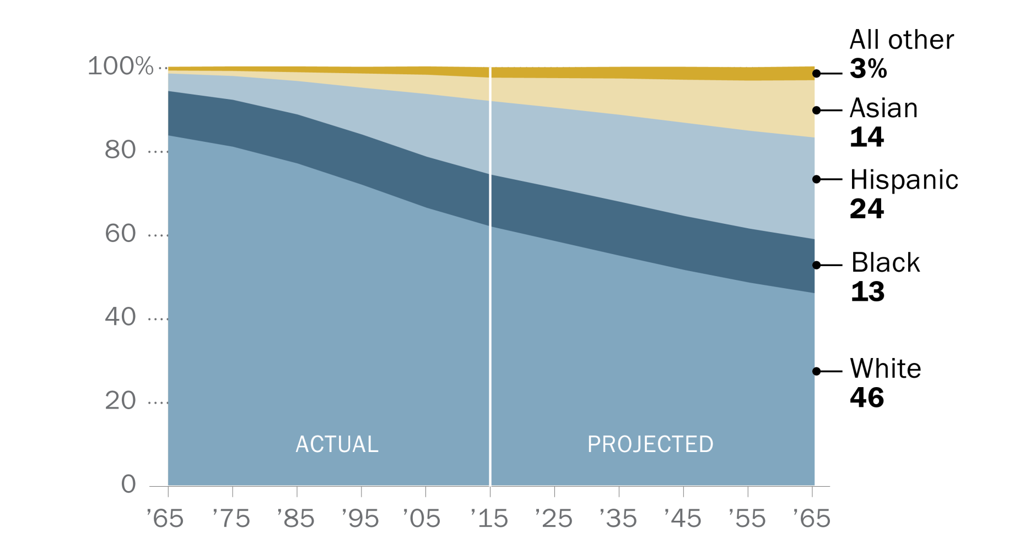

A century of U.S. population change, 1965 to 2065

Slide 6
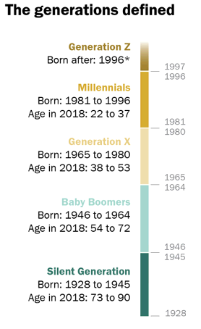
Generation Z: Born in 1996 or later
Notes:
*No chronological endpoint set for Generation Z. In any analysis of survey data, Generation Z includes those ages 13 to 21 in 2018.

Slide 7
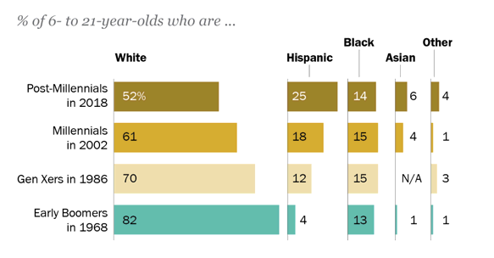
Hispanics are one-in-four among Generation Z
Notes:
Note: Racial groups include only single-race non-Hispanics. Hispanics are of any race. Asians include Pacific Islanders. The CPS data here did not separately identify Asians until 1988. Hispanic origin was not collected until 1971. The racial and ethnic composition of Boomers in 1968 was imputed on the basis of 8- to 23-year-olds in the 1970 census. Subsequent to this analysis, Pew Research Center has used the term “Generation Z” instead of “Post-Millennials.” Source: Pew Research Center analysis of 1986, 2002 and 2018 Current Population Survey Annual Social and Economic Supplements and 1970 decennial census (IPUMS) “Early Benchmarks Show Post-Millennials on Track to Be Most Diverse, Best-Educated Generation Yet”

Slide 8
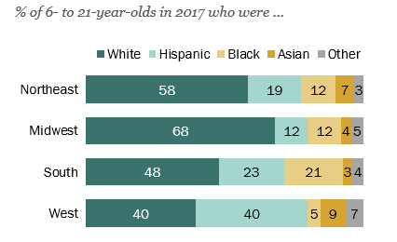
I
In the West, Generation Z equally likely
to be Hispanic and white
Notes:
Note: Racial groups include only single-race non-Hispanics. Hispanics are of any race. Asians include Pacific Islanders. Source: Pew Research Center analysis of U.S. Census Bureau vintage 2017 county population estimates. “Early Benchmarks Show Post-Millennials on Track to Be Most Diverse, Best-Educated Generation Yet”

Slide 9
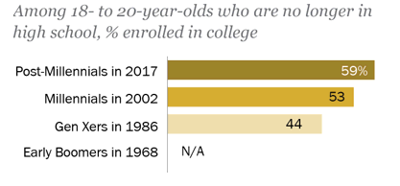
More of today’s young adults pursuing college
than previous generations
Notes:
Note: Subsequent to this analysis, Pew Research Center has used the term “Generation Z” and not “Post-Millennials.” Source: Pew Research Center analysis of 1968, 1986, 2002 and 2018 Current Population Survey Annual Social and Economic Supplement (IPUMS) and 1986, 2002 and 2017 Current Population Survey October Supplement (IPUMS). “Early Benchmarks Show Post-Millennials on Track to Be Most Diverse, Best-Educated Generation Yet”

Slide 10

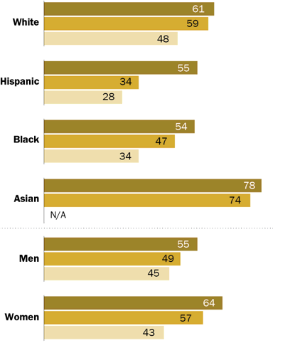

Gains in college enrollment across groups
Notes:
Note: Racial groups include only single-race non-Hispanics. Hispanics are of any race. Asians include Pacific Islanders. The CPS did not separately identify Asians until 1988. Source: Pew Research Center analysis of 1986, 2002 and 2017 Current Population Survey October Supplements (IPUMS)

Slide 11
About three-in-ten school-age children today live with an unmarried parent
Notes:
Note: Excludes 6- to 17-year-olds living in group quarters, householders and their spouses. Subsequent to this analysis, Pew Research Center now uses “Generation Z,” not “post-Millennials.” Source: Pew Research Center analysis of 1968, 1986, 2002 and 2018 Current Population Survey Annual Social and Economic Supplement (IPUMS) “Early Benchmarks Show Post-Millennials on Track to Be Most Diverse, Best-Educated Generation Yet”

Slide 12
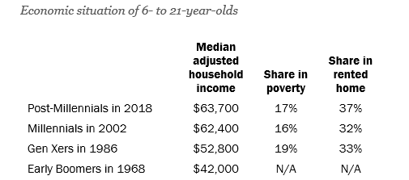
B
By some measures, today’s young people are better off than earlier generations
Notes:
Note: Household incomes are as of the previous calendar year and are scaled to a three-person household and expressed in 2017 dollars. Poverty status is as of the previous year. Housing tenure as of March of the given year. Subsequent to this analysis, Pew Research Center has used “Generation Z,” not “Post-Millennials.”
Source: Pew Research Center analysis of 1968, 1986, 2002 and 2018 Current Population Survey Annual Social and Economic Supplement (IPUMS).
"Early Benchmarks Show Post-Millennials on Track to Be Most Diverse, Best-Educated Generation Yet”

Slide 13
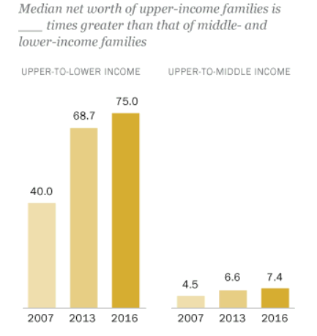
Wealth gaps are at highest levels ever recorded
Notes:
Source: Pew Research Center analysis of Survey of Consumer Finances public-use data. “How wealth inequality has changed in the U.S. since the Great Recession, by race, ethnicity and income.”

Slide 14
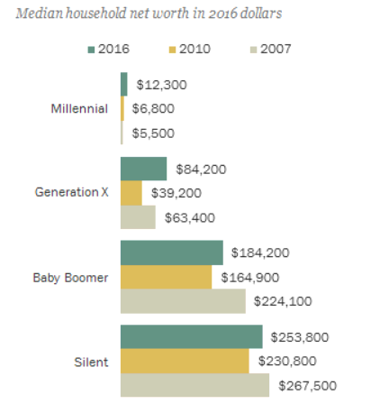
Only younger generations have recovered wealth since the recession
Notes:
Source: Pew Research Center analysis of Survey of Consumer Finances public-use data. “Gen X rebounds as the only generation to recover the wealth lost after the housing crash”

Slide 15
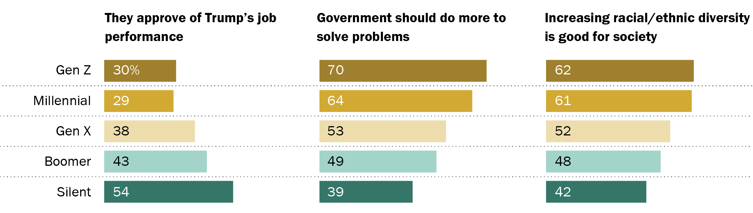
Younger Americans see a bigger role for government
Notes:
Source: Surveys of U.S. adults ages 18 and older conducted Sept. 24-Oct. 7, 2018, and U.S. teens ages 13 to 17 conducted Sept. 17-Nov. 25, 2018.
“Generation Z Looks a Lot Like Millennials on Key Social and Political Issues”

Slide 16
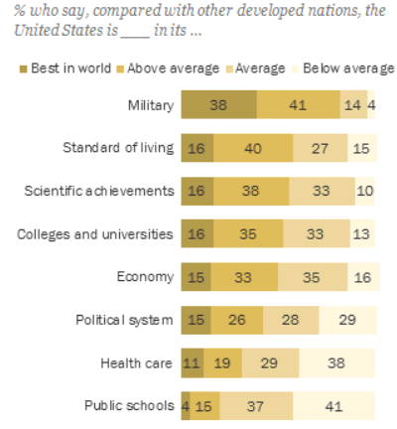
What do Americans think of U.S. colleges and universities?
Notes:
Note: Don’t know responses not shown. Source: Survey of U.S. adults conducted March 7-14, 2018. “Americans say U.S. colleges make the grade, but many say public schools don’t measure up”

Slide 17
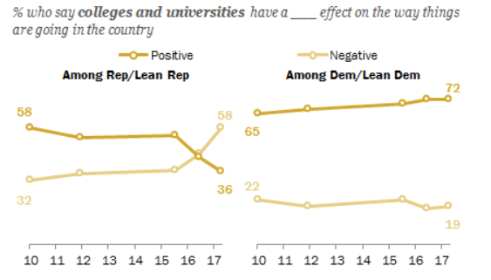
Differences by party on positive/negative impact of colleges and universities
Notes:
Note: Don’t know responses not shown. Source: Survey conducted June 8-18, 2017. “Sharp Partisan Divisions in Views of National Institutions”

Slide 18
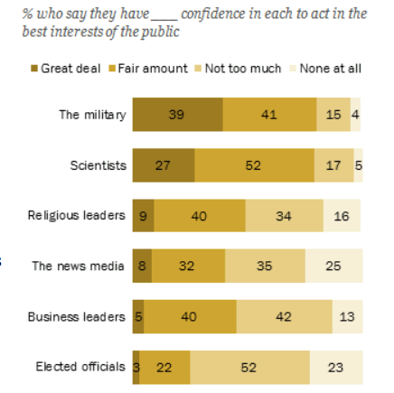
How much confidence do Americans have in national leaders and institutions?
Notes:
Note: No answer not shown. Source: Survey of U.S. adults conducted Jan 29-Feb 13, 2018. “The Public, the Political System and American Democracy”

Slide 19
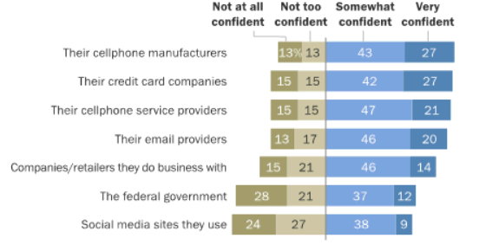
How co
How confident are Americans that their data is protected by …
Notes:
Note: Data on cellphone manufacturers and service providers based on cellphone owners; data on email providers based on internet users; data on social media sites based on social media users. Data for credit card companies recalculated to exclude “does not apply” responses. Otherwise, refusals and “does not apply” responses not included in this chart. Source: Survey conducted March 30-May 3, 2016. “Americans and Cybersecurity.”

Slide 20

Adapting to the New America
\
Julio Arrieta
Managing Director /
Chief Marketing Officer
The New American Mainstream Opportunity and How To Activate It

Slide 21
College Savings Participation –
By Race/Ethnicity
Overall adoption of college saving accounts are relatively low
Particularly among Hispanics and African Americans
Almost 80% of all 529 Savings accounts are held by Non-Hispanic White households
 | Total | NHW | Hispanic | AA | NH Other
Total Households (000s) | 120,077 | 81,938 | 15,222 | 14,783 | 8,133
Have College Savings | 3.3% | 3.8% | 1.2% | 2.2% | 3.2%
HHs with College Savings (000s) | 3,912 | 3,144 | 184 | 326 | 258
HHs with 529s (000s) | 2,882 | 2,372 | 154 | 153 | 204
529 COLLEGE SAVINGS | 2.4% | 2.9% | 1.0% | 1.0% | 2.5%
HHs with 529s (000s) | 1,258 | 928 | 83 | 184 | 64
OTHER COLLEGE SAVINGS | 1.0% | 1.1% | 0.5% | 1.2% | 0.8%
Source: Simmons Research Spring 2016 2-year study

Slide 22
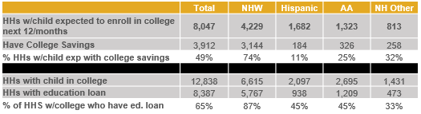
College Savings Participation –
by HHS with College Bound Kids
Only half of HHs with members expected to enroll in college in the next 12 months have college savings
The number is lowest among Hispanics where only 11% of such HHs have college savings
Almost three quarters of non-Hispanic white households have college savings
Interestingly, among HH with members enrolled in college, non-Hispanic whites have a higher likelihood to have education loans outstanding (87%) than Hispanic or African American HHs (45%)
Source: Simmons Research Spring 2016 2-year study

Slide 23
Attitudinal Differences College Savings
Participation – Household Composition
Less savvy when it comes to Financial services
More loan-averse
High level of distrust in banks
However, open to advertising for Financial Services
Source: Simmons Research Spring 2016 2-year study

Slide 24
College Planning
Segment Profiles

Slide 25
College “The Next Step”
Non-Hispanic White
Why College?
The functional view, to prepare for the future and it’s earnings.
For NH White parents focus more on the functional aspects, such as college being a means to preferred occupation (67%) or earnings (55%) rather than it being really expected in the family (35%) or part of the American dream (40%)
Slightly less likely to send child to college for intellectual/social experience regardless of whether they would earn more money (19%, 86 index)
How to pay for it?
Plan, apply for scholarships, work for it and borrow the rest.
HA and NH White parents equally likely to have a plan & contingency plan to pay for college, but less likely than AA
This segment received the most grant money with an average of $7,942 (106 index) and scholarship money with an average of $9,831 (110 index)
NH White families are slightly more likely to have borrowed money to pay for college (43%, 105 index)
NH White children are slightly more likely to work more (57%, 110 index) to make college more affordable, in fact 61% work year round (107 index)
Where to go?
A 4-year college with the right academics
More likely to be attending a 4-year public (46%) or private college (24%)
More chose the college based off the academic program (35%, 113 index)
Stressors
More knowledgeable and less impacted by outside sources, they’re less stressed.
Across ethnic groups education expenses is the #1 stressor within their household finances. 30% of NHW find themselves constantly or frequently stressed about it, followed by housing (1%) and medical (16%) expenses
When thinking about paying for college they are less stressed overall and less worried about economic factors impacting them than the other groups, however their top worries are school raising tuition (21%) and loan rates increasing (20%)
Source: Analysis of “How American Pays for College 2016” Sallie Mae’s national study of college students and parents data.

Slide 26
College “The American Dream”
Hispanics
Why College?
Because it’s the American Dream, for experience and to show progress.
The main reasons they want their kids to continue their education is that they see a college education as part of the American Dream (60%, 140 index) and they want them to get the college degree required for their desired occupation (75%, 112 index)
Most likely to see having a college degree as more important now than it used to be (73%, 107 index) and be willing to send them for the intellectual/social experience regardless of whether they would earn more money (35%, 159 index)
How to pay for it?
Debt averse, they are more likely to stretch, make compromises and pay it from their pocket.
HA and NH White parents equally likely to have a plan & contingency plan to pay for college, but less likely than AA
Payment from parent current income is 24% of total cost (133 index), 7% from student current income (140). Only 32% of HA families borrowed to pay for college (78 index)
Hispanics received the least amount in scholarship money with an average of $7,131 (79 index) and they are less likely than others to have received it from the college itself (48%, 82 index)
Least likely to have completed a FAFSA application (77%, 91 index)
HA parents are more likely to be willing to stretch themselves financially to obtain the best opportunity for their child’s future. (68%, 121 index)
HA children also take many actions to make college more affordable including being more likely to live at home (66%, 135 index), reduce their spending (71%, 115), shorten time to graduation (31%, 120) and stay in-state (77%, 110)
Where to go?
Definitely a public school, and more likely than others to go to a 2-year based on cost.
Equally likely to be attending a 4-year public (46%) college, but less likely to attend a 4-year private college (12%, 52 index). Most likely of segments to attend a 2-year public college (42%, 135 index)
More chose the college based off annual cost before financial aid (21%, 124 index) and personal choice (38%, 123 index)
Stressors
They can’t disappoint and the threat of external economic factors worries them greatly.
Across ethnic groups education expenses is the #1 stressor within their household finances. 31% of Hispanics find themselves constantly or frequently stressed about it, followed by medical (15%) and insurance (15%) expenses)
When thinking about paying for college they are particularly worried about not wanting to disappoint their child If they can’t afford to pay or they have to drop out (21%, 140). They are worried about economic factors impacting them almost across the board but particularly that their income will decrease due to job loss (23%, 209 index) and that their life insurance is insufficient to cover costs if they die (26%, 236 index)
Source: Analysis of “How American Pays for College 2016” Sallie Mae’s national study of college students and parents data.

Slide 27
College “The Plan”
African American
Why College?
For a better life, to advance and earn.
AA is more likely to cite the main reasons they want their kids to continue their education as the fact that college is expected in their family (54%, 129 index) and they want their child to earn more money with a college degree (66%, 116 index
How to pay for it?
With a plan, one that includes many sources including scholarships, financial aid, and loans.
AA parents most likely to say they had a plan to pay for all years of college (25%, 132 index) and a contingency plan for unexpected events (20%, 133 index)
Payment also comes from current income, but they over-index in loans and student savings
They are less likely than other groups to use student (45%) or parent (54%) income and savings.
Although they received an average amount in scholarships, this makes up for less of their total costs (16% of total cost, 84 index). They are more likely than others to have received it from the college itself (70%, 121 index)
Most likely to have completed a FAFSA application (94%, 111 index)
Where to go?
A 4-year college with a great financial aid package.
More likely to be attending a 4-year public (46%) or private college (25%)
More chose the college based off the financial aid package the school was giving (17%, 170 index)
More likely than others to eliminate a college from consideration due to cost at every step in the application process, but most of all after looking at the financial aid packages (54%, 123 index)
Stressors
More worried about being informed and whether they can manage rather than external factors.
Across ethnic groups education expenses is the #1 stressor within their household finances. 30% of AA find themselves constantly or frequently stressed about it, followed by housing expenses (16%)
When thinking about paying for college they are more worried about not being informed enough about their options (31%, 115 ), unsureness of future aid (63%, 156), balancing expenses (56%, 117) and external factors such as scholarship/grant money becoming less available (23% , 128 index) and loan rates increasing (22%)
Source: Analysis of “How American Pays for College 2016” Sallie Mae’s national study of college students and parents data.

Slide 28
Succeeding In The New American Mainstream:
AN OMNICULTURAL APPROACH

Slide 29
For marketers to succeed in today’s environment, they must understand that there is a “New American Mainstream” unlike that of the past.
And, as such, they must understand what is driving that change and they must be open to operating with the diversity and complexities that come with it rather than trying to simplifying it for efficiency’s sake.
Speaking to more people effectively can’t be
done by oversimplifying

Slide 30
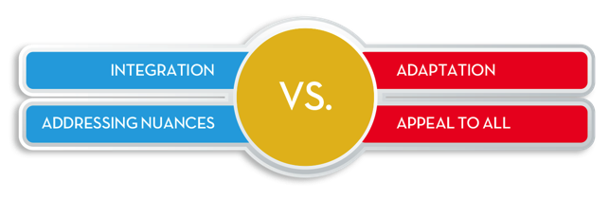
So, What’s The Conundrum?

Slide 31
Hence, the Need to Adopt
AN OMNICULTURAL APPROACH

Slide 32
Omnicultural
An approach used to address diverse cultural segments which now comprise the new mainstream, understanding how different cultures interact and borrow from one another without losing their identity or alienating the others...
In a comprehensive manner, considering how people truly live
Requiring both strategic and tactical cultural competence to achieve optimum relevance, response, and growth.

Slide 33
Omnicultural: Key Tenets
Inclusive of Caucasian, Hispanic, African-American, Asian-American, and/or any other culture that makes up the targeted market
Campaigns should reflect the increased diversity of the US population, as well as the impact of multiculturalism on American culture, going beyond casting
Total Market creative campaigns should use cultural cues and elements that:
  Draw on universal truths
  Come from experiences of different ethnic groups
  Use talent appropriately
Not at the expense of powerful segment-specific work
Combination of strategic and tactical actions

Slide 34

Strategy Or Tactics? Yes
STRATEGY
TACTICS
+
Relevancy Level
Leverages Diversity
Understands Cultural Interactions
Engagement Level
Connect Meaningfully
Reach Personally
Deploy contextually

Slide 35
Cultural Nuances
Hispanics
Non-Hispanics
Family
Priority.
Family extends to neighbors and friends.
Independence is selfish and disloyal.
Nuclear family, encouraged to
be independent.
Orientation
Focus on group and community,
looking out for others and achieving
group harmony.
Focus on the individual, independence,
and personal fulfillment.
Personal Space
Close.
At arm’s length.
Control
Little control over destiny, adapts to
problems, changes disrupt harmony.
Individuals have control, problems can be fixed and change is good.
Time
Relative. Human needs are more important, deadlines can be changed.
Rigid (and stressful)
deadlines and schedules.
Communication
Indirect. If it is upsetting,
don’t say it or “soften” it.
Direct. Say what you mean and
mean what you say.
Sources: Simmons, Fall 2016 NHCS Adult Study 2-Year.

Slide 36
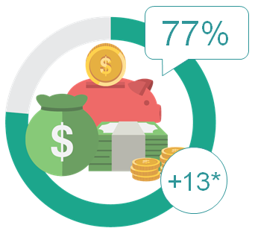
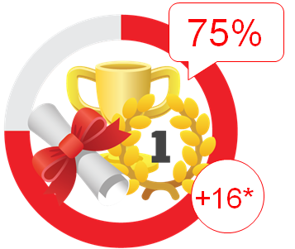
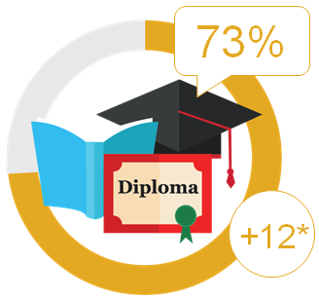
Cultural Nuances (Hispanic Millennials)
Optimistic About
Earnings potential
Having a more fulfilling
life than their parents
Their educational
opportunities
Sources: Simmons, Fall 2016 NHCS Adult Study 2-Year. Mintel: Marketing to Hispanic Millennials

Slide 37
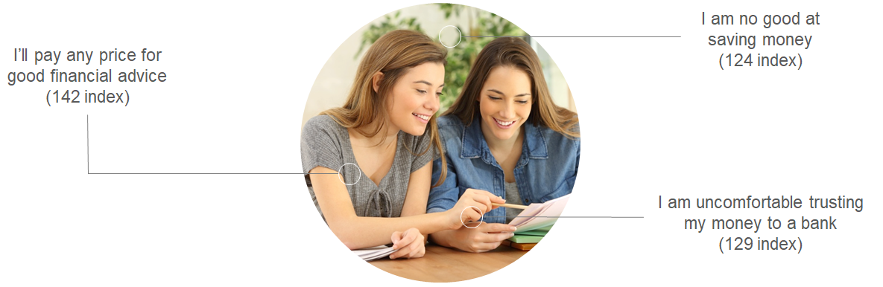
Cultural Nuances (Hispanic Millennials) (Cont’d)
Need Financial Advice
I am no good at saving money
(124 index)
I’ll pay any price for good financial advice
(142 index)
I am uncomfortable trusting my money to a bank
(129 index)
Sources: Simmons, Fall 2016 NHCS Adult Study 2-Year. Mintel: Marketing to Hispanic Millennials

Slide 38
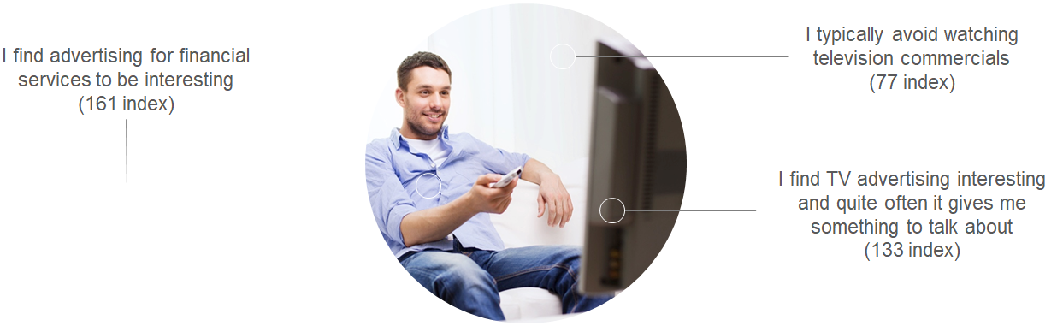
Cultural Nuances (Hispanic Millennials) (Cont’d)
More Open to Advertisements
I find advertising for financial services to be interesting
(161 index)
I typically avoid watching television commercials
(77 index)
I find TV advertising interesting and quite often it gives me something to talk about
(133 index)
Sources: Simmons, Fall 2016 NHCS Adult Study 2-Year. Mintel: Marketing to Hispanic Millennials

Slide 39
Key Differences – Value Orientation
Hispanics
Non-Hispanics
How do you define yourself?
Collective
Individuals
Who do you rely on for help?
Family/Friends
Ourselves/Institutions
What do you value in people?
Social Standing/Background
Individual Accomplishments/Meritocracy
What do you stress in a relationship?
Respect/Formality
Independence
Roles in social relationships
Hierarchies
Egalitarian
Values
Morals
Ethics
View on life
Spirituality
Self-Determination
Sources: Simmons, Fall 2016 NHCS Adult Study 2-Year.

Slide 40
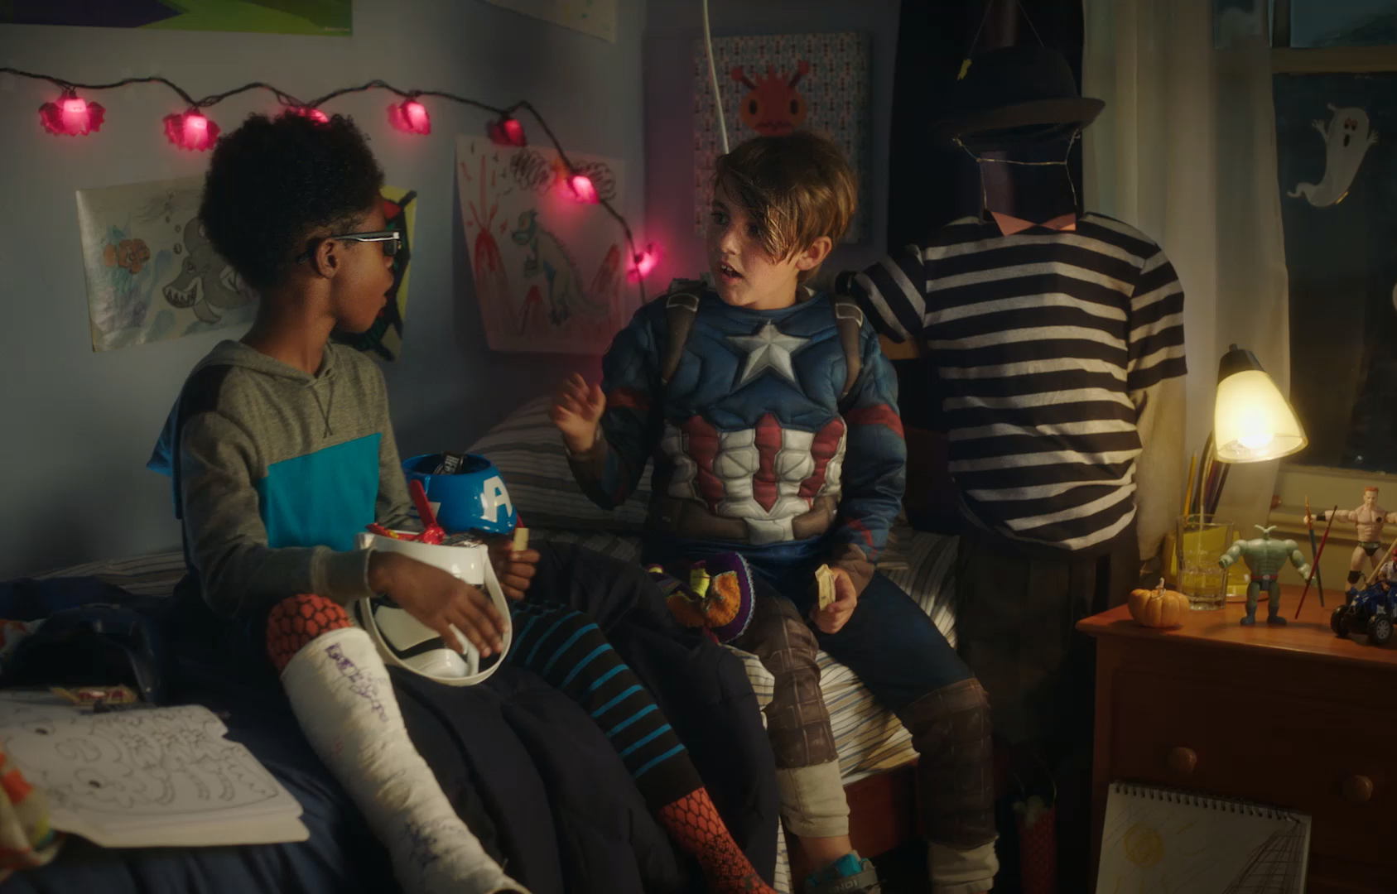
Omnicultural Best Practice Example:
Walmart

Slide 41

529 Marketing Implications
Wilson Camelo President /
Chief Marketing Officer

Slide 42
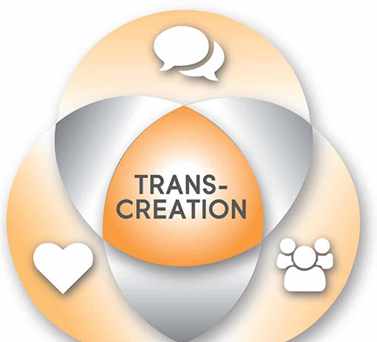
Translation v. Transcreation
  • Translation focuses on language
  • Transcreation focuses on context and takes into consideration insights and cultural relevance
Language
Insights
Culture

Slide 43
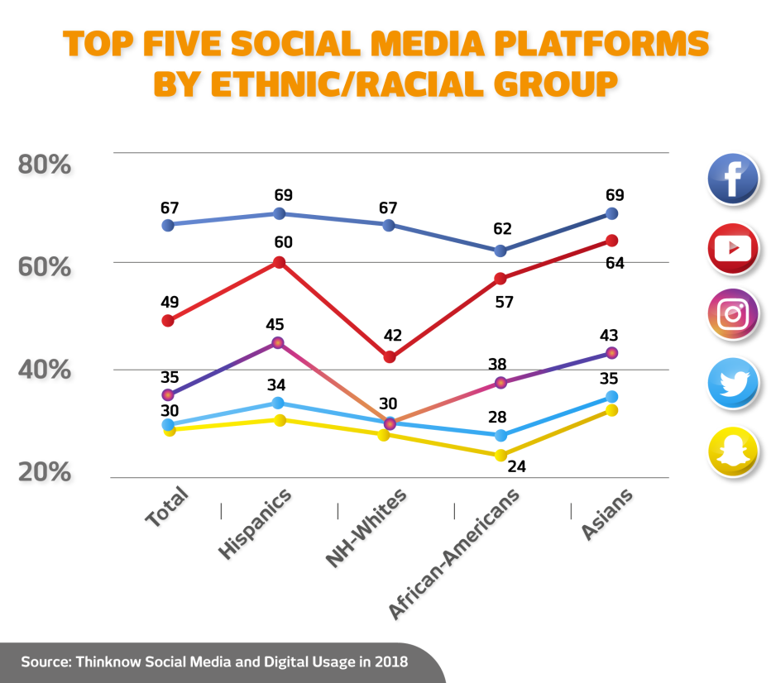
Approaches for Success
  • Conduct a readiness assessment
  • Think digital and social
  • Public relations educates and
  builds trust
  • Test, learn … then scale

Slide 44


Evaluate (or Reevaluate) Your Market
  • With rapid demographic changes, can not assume your target market is the same as it’s been … or will be in the future
  • Allocate budgets and resources to reflect target
  • Paying particular attention to those with younger children in
  the household

Slide 45
Thank You!
Diverse U.S. Demographics: Outreach in an Evolving Landscape

