Slide 1
Planning, Pilot Programs, and Partnerships: Encouraging Low and Moderate Income Families to Save For College

Slide 2
Moderator & Presenters
Moderator:
Julie Shields-Rutyna, Director of Early College Planning, MEFA
Presenters:
Sandy Baum, Senior Fellow, Urban Institute
Kim Miller, SOAR Virginia® Program Manager, Virginia529
Alayna VanTassel, Deputy Treasurer and Executive Director, Office of Economic Empowerment, Massachusetts State Treasurer’s Office

Slide 3
The Challenge of Saving for College
Sandy Baum
Urban Institute
College Savings Foundation
March 2019

Slide 4
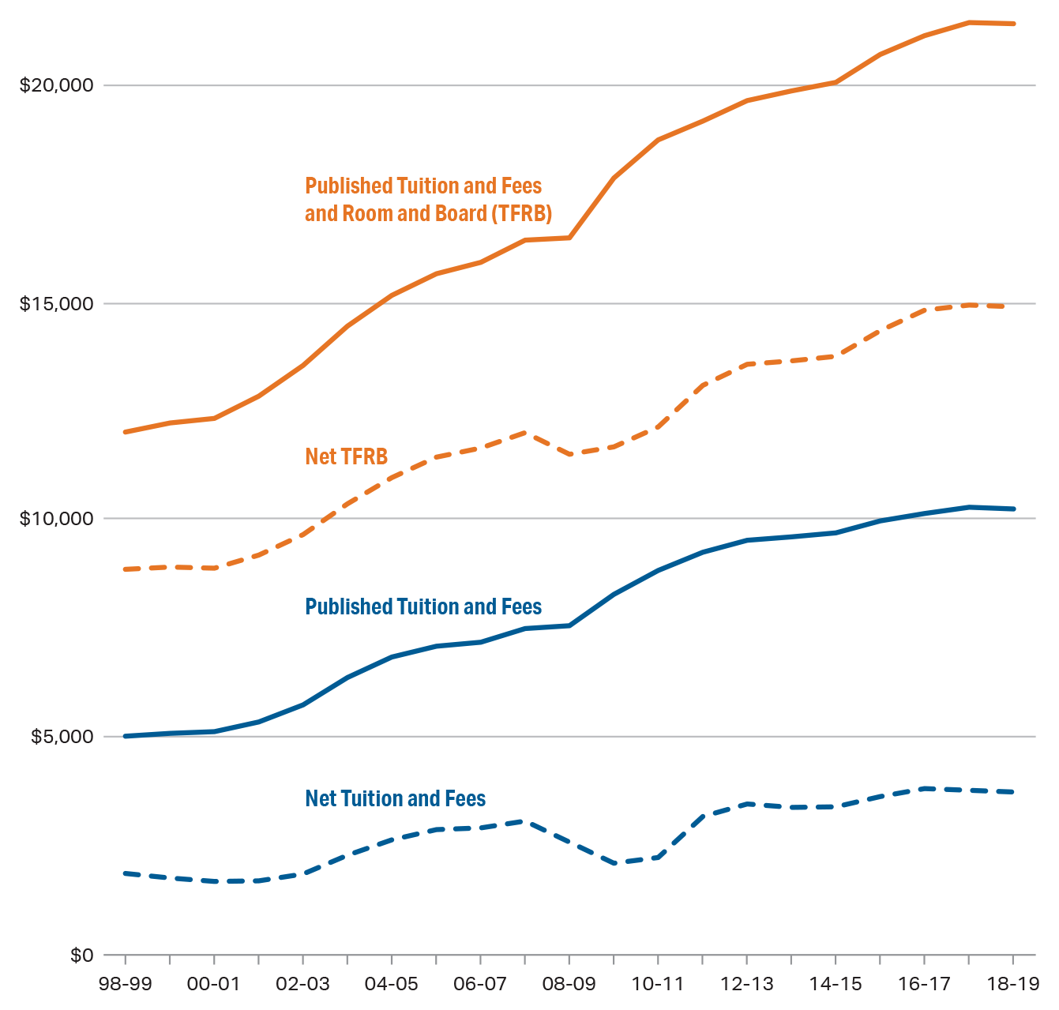
Average Published and Net Prices
Average Published and Net Prices in 2018 Dollars, Full-Time In-State Undergraduate Students
Public Four-Year Institutions, 1998-99 to 2018-19
Source: The College Board, Trends in College Pricing 2018, Figure 9.

Slide 5
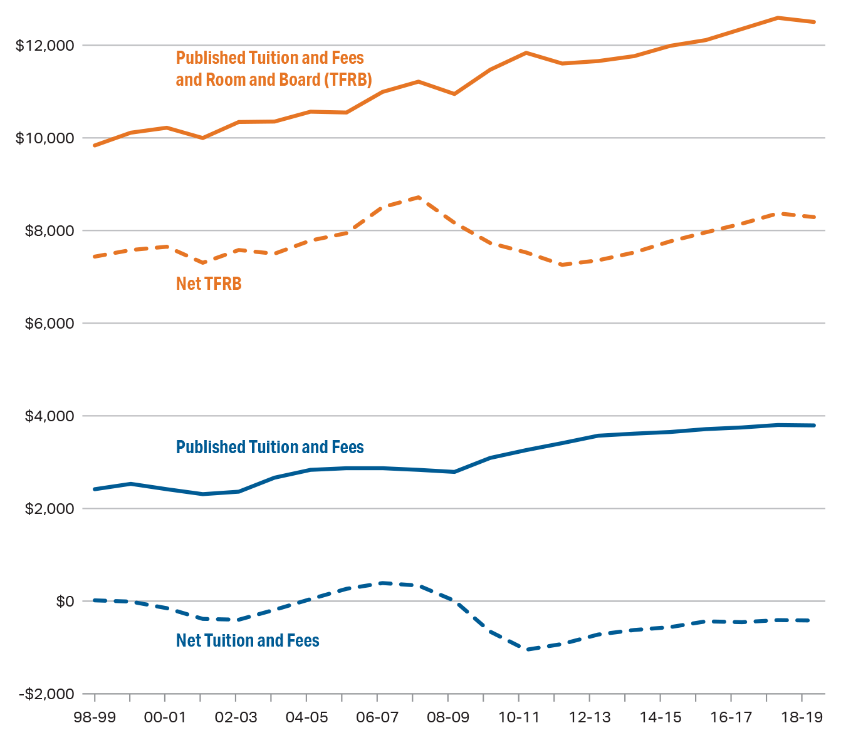
Average Published and Net Prices
Average Published and Net Prices in 2018 Dollars, Full-Time In-District Undergraduate Students
Public Two-Year Institutions, 1998-99 to 2018-19
Source: The College Board, Trends in College Pricing 2018, Figure 8.

Slide 6
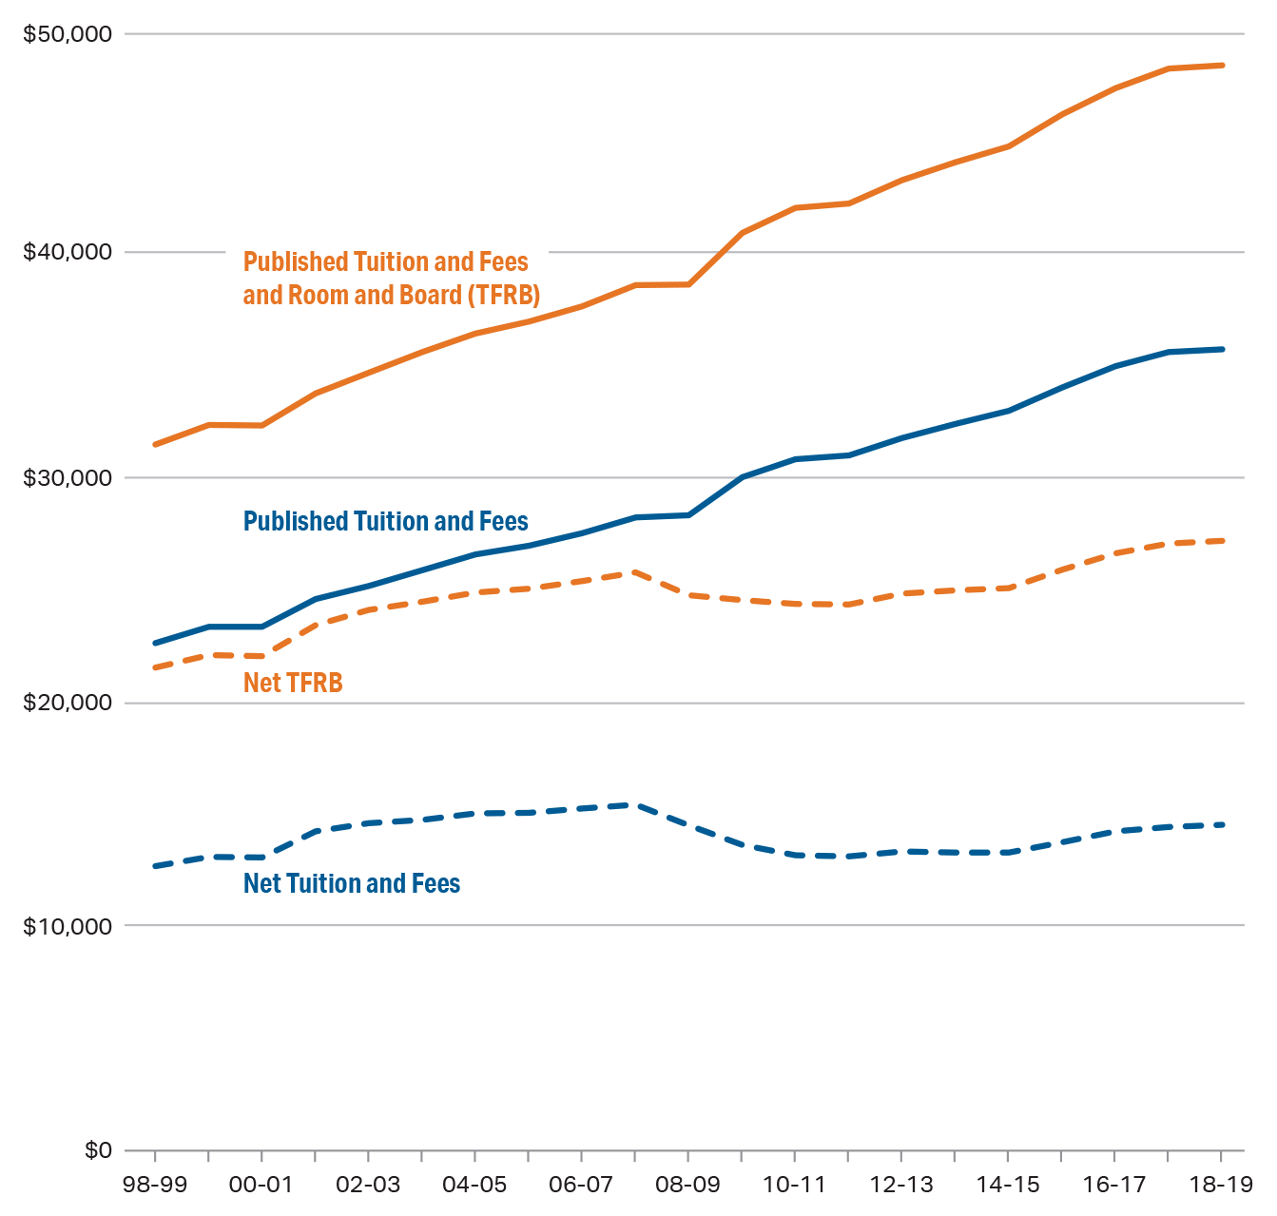
Average Published and Net Prices
Average Published and Net Prices in 2018 Dollars, Full-Time Undergraduate Students
Private Nonprofit Four-Year Institutions, 1998-99 to 2018-19
Source: The College Board, Trends in College Pricing 2018, Figure 10.

Slide 7
Average Incomes
Average incomes have increased measurably only at the upper end of the income distribution.
Average family income by income quintiles and for top 5%, 1967 - 2017.
Source: US Census Bureau

Slide 8
Mean Incomes
Income inequality underlies affordability problems.
Mean income of each fifth and top 5 of families, 2007, 2012, and 2017
Source: U.S. Census Bureau 2017, Table F-3.

Slide 9
Savings Rate
The personal savings rate has declined over time.
Source: Federal Reserve Economic Data (FRED), Federal Reserve Bank of St. Louis

Slide 10
Encouraging Savings
Most subsidies go to the relatively affluent
Families with 529 Accounts: (GAO 2012)
25 times median financial assets of those without
3 times the with college degrees about twice as high as for families without 529 plans
Retirement Plans
About 40% of families ages 35-64 in bottom half of income distribution participate.
In the top 10%, almost everyone participates.
(Board of Governors of the Federal Reserve System, Survey of Consumer Finances)

Slide 11
Sample of Recent Proposals
2005, bipartisan group of senators: ASPIRE Act — $500 investment account for every newborn. Chuck Schumer, (D-NY), Rick Santorum (R-PA), Jim DeMint (R-SC), Jon Corzine (D-NJ)
Rethinking Student Aid (2008) — Federal funding of accounts for low-income children based on hypothetical Pell eligibility. Only for college. No matching.
Hillary Clinton (2008) $5,000 baby bond for each child born — For home or college.
Sen Cory Booker (D-NJ) America Opportunity Accounts Act — Savings account for every child when born. Federal government makes payments up to $2,000 each year based on family income until child turns 18. For home or college. No matching

Slide 12
Proposals
Proposals to help create college savings for low-income students are not new
Universal or need based?
Income or savings?
Restricted purpose?
Require matching?

Slide 13
Advantages and Disadvantages
Competing needs: Lifelong learning accounts
529 Accounts: greatest benefit at higher incomes
Bigger benefits for higher marginal tax rates
Financial aid system reduces aid for parents/students with these assets (or counts withdrawals as income is owned by others)
Penalties for other uses
Matching: Who is left out?

Slide 14
What Are The Goals?
Provide funds and increase expectations about college-going
Reduce inequality in resources and opportunities
Change behavior of low-income households

Slide 15
An Early Commitment Scholarship Program Kim Miller, Program Manager for SOAR Virginia
Notes:
Started in 2010; agency’s mission to make college more accessible and affordable for all Virginians

Slide 16
What Is It?
Early Commitment
Advising
Scholarship Support
Notes:
Early commitment- 10th-12th grades
2.5 GPA, National School Lunch, Virginia resident, Legal US Resident, US Citizen
Partner with access providers who work with students- maintain 2.5 GPA, community service, attend school regularly, code of conduct, financial literacy
Earn up to $2,000

Slide 17
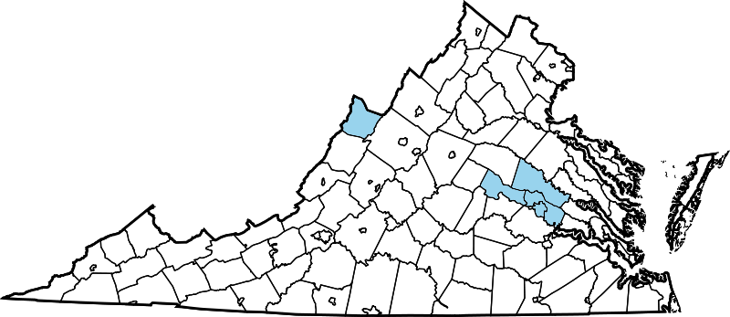
In The Beginning
SOAR Virginia began in 2010
GRASP - 103 students in 7 schools
Notes:
Began 2010, Permanent 2015

Slide 18
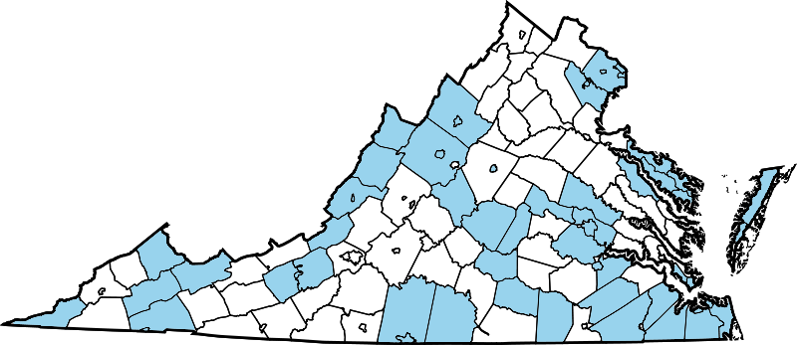
As Of 2017-2018

Slide 19
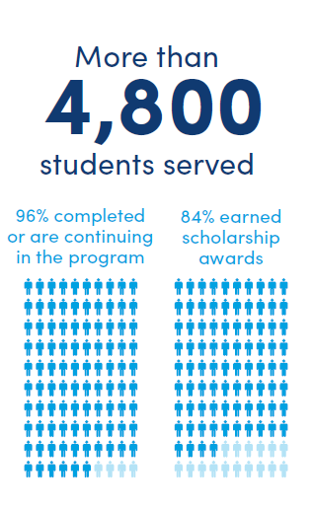
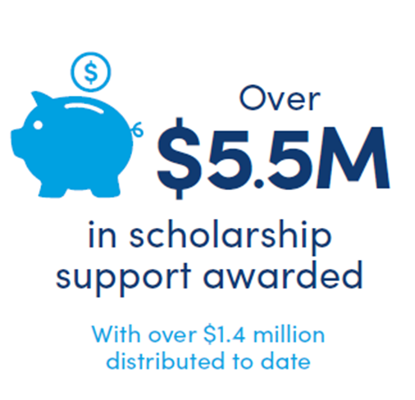
As Of 2017-2018
Notes:
Main reasons students don’t earn awards- don’t maintain 2.5 GPA and don’t complete community service

Slide 20
As Of 2017-2018
In-State vs Out of State
Public vs Private
4 Year vs 2 Year
11%
19%
24%
89%
81%
76%
Notes:
Of the ones we KNOW are attending college
Highest attended college- ODU 138 SOAR graduates
Represents 1,168 SOAR grads who have taken distributions

Slide 21
More Information
www.virginia529.com/soar
Kim Miller - kmiller@virginia529.com
Kimberly Miller is the Program Manager for the SOAR Virginia® Early Commitment Scholarship Program administered by Virginia529. She began working at Virginia529 in August 2012. Prior to that time, she worked in financial aid and academic counseling at John Tyler Community College for more than 10 years. Kimberly has a Bachelor of Social Work degree from James Madison University and a Master of Education degree in Adult Education and Human Resources Development from Virginia Commonwealth University.
Notes:
Check out website for more info, email me with questions

Slide 22
Alayna Van Tassel
Deputy Treasurer Executive Director of the Office of Economic Empowerment

Slide 23
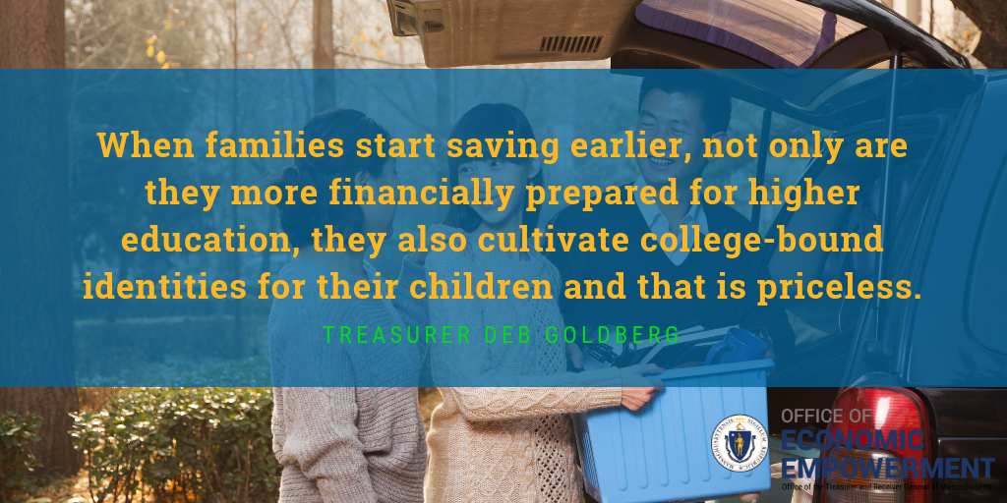

Slide 24
Massachusetts CSA Pilots

Slide 25
SeedMA Pilot
The program provides kindergarten students in Worcester and Monson with an initial $50 deposit to establish a Massachusetts 529 college savings account (also known as the U.Fund College Investing Plan).

Slide 26
Seed MA 3-Year Pilot
1.
Increase the percentage of children saving for higher education in Massachusetts;
2.
Deliver high-quality financial education programming to families, building a culture centered on saving for the future and employing prudent budget management;
3.
Boost postsecondary enrollment and graduation rates for Massachusetts students by fostering aspirations of higher education for economically vulnerable and disadvantaged children.

Slide 27
SeedMA Community Engagement
Over 60 distinct partner organizations play an important role in the advocacy, outreach and enrollment in SeedMA.
They work directly with their respective client populations to ensure that every eligible family in the city is exposed to SeedMA through a variety of authentic, trusted sources.
One fulltime staff member is based in Worcester to oversee the enrollment and community engagement.
All materials distributed through the Worcester Public Schools are translated into eight languages.

Slide 28
SeedMA Savings
Total contributions $32,847
33% of families who opened accounts have saved
13% of families set up direct deposits
65% of parents reported that they had not saved for their child’s postsecondary education prior to opening their SeedMA account.

Slide 29
SoarMA
A two-year pilot program created to help low-income Massachusetts children and families save for postsecondary education and training.
Created through enactment by the Massachusetts Legislature.
The initiative, funded through public-private partnerships, will provide a matched savings program and a financial education curriculum.

Slide 30
SoarMA Schools
The program opened to all seventh graders enrolled in the following middle schools starting in the 2017-2018 school year:
Haverhill: Consentino Middle School
Lowell: Stoklosa Middle School
Pittsfield: Reid Middle School
Springfield: South End Middle School
Worcester: Worcester East Middle School

Slide 31
Massachusetts CSA Pilot Learnings
Successes
Over 1,000 kindergarten students and families participated in SeedMA activities.
60 partner agencies and organizations set up 65 events at 49 city-wide locations.
33% of families are saving in their CSA.
Challenges
Decentralized school system in Massachusetts
School districts have different levels of engagement and capacity.
Reaching low and moderate income families
Many families have already established college savings accounts.

Slide 32
SoarMA Video

Slide 33
SoarMA Video (Spanish)

Slide 34
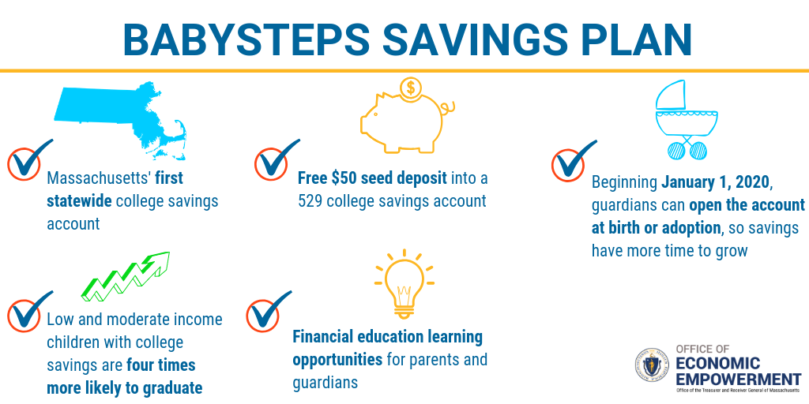
BabySteps Saving Plan

Slide 35
BabySteps Savings Plan: At-Birth CSA Expansion
The BabySteps Savings Plan will dedicate its resources in support of three principal goals:
Increase the percentage of children saving for higher education in Massachusetts;
Deliverer high-quality financial education programming to families, building a culture centered on saving for the future and employing prudent budget management; and
Boost postsecondary enrollment and graduation rates for Massachusetts students by fostering aspirations of higher education for economically vulnerable and disadvantaged children.

Slide 36
Baby Steps Savings Plan: At-Birth CSA Expansion
States with successful at-birth CSA programs:
Rhode Island
Maine
Connecticut
46 Birthing Hospitals or Clinics
VS.
1113 Elementary Schools

Slide 37
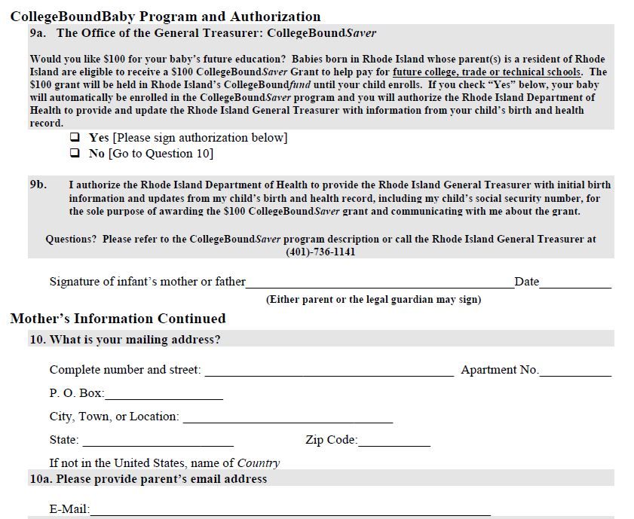
Rhode Island Mother’s Worksheet for Birth Certificate

Slide 38
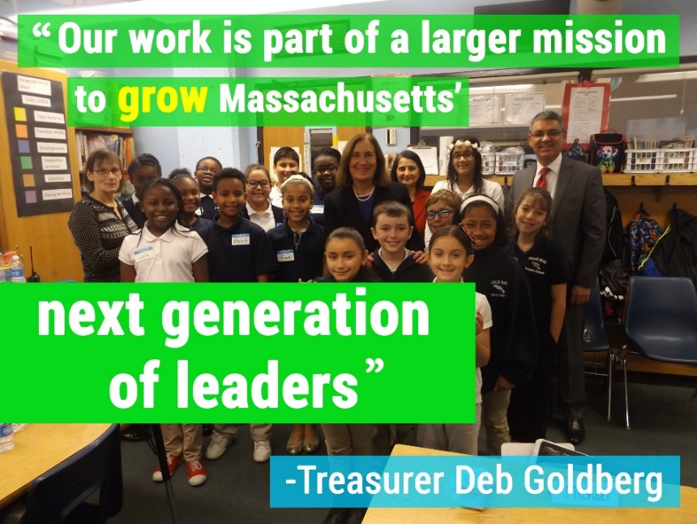
Thank you!
Thank you!
We’re social
Follow Us!
@EmpowermentMA
@EconomicEmpowermentMA

